Slide 1

Gonymizer
A Tool to Anonymize Sensitive PostgreSQL Data Tables
for Use in QA and Testing
Levi Junkert

Slide 2
Agenda
Introductions
HIPAA Regulations
SmithRx Solution: Gonymizer
Gonymizing multiple environments using Kubernetes
Demo
Wrap-up

Slide 3
Who am I?
Database systems 18 years
MySQL
PostgreSQL
Software Engineering 11 years
Product, Infrastructure, and Automation
DB and SE Experience
Facebook
RightNow ( Oracle)
OpenDNS (Cisco)
Get Better

Slide 4
Services Agreement
Formulary Agreement
Manufacturer
Self-Insured Employer
Wholesaler Payment for Product
Formulary Rebates
Service and Data Fees (specialty )
Pass through of rebate
PBMs sit in the middle of a large and complex ecosystem
Product Shipment
Drug Wholesaler
Pharmacy Benefit Manager
Serv. Contract
Product Shipment
Payer Reimbursement
to PBM
Pharmacy Payment for Product
Prescription Reimbursement
Pharmacy
Vendor Agreement
Network Participation
Dispense Prescription
Copayment or Coinsurance
Patient
Financial Flow
Contract Relationship
Product Movement
Fein, Adam. J., The 2016 Economic Report on Retail, Mail and Specialty Pharmacies, Drug Channels Institute, January 2016 .

Slide 5

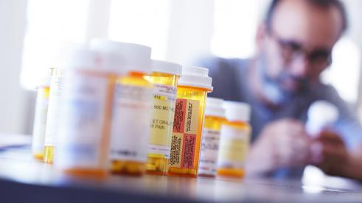
Notes:
Joe Schmoe loads a SQL dump of the production database to his laptop
He stored patient files (unencrypted) on his laptop for testing bugs in his new UI
His machine isn’t encrypted
He is at Starbucks when 3 people rush in and steal his and 3 other’s laptops
Think this can’t happen to you?
NEXT SLIDE =>

Slide 6
HIPAA Regulations
Health Insurance Portability and Accountability Act of 1996
United States Legislation
Notes:
Anonymize
Talk about how we can solve this problem by showing the process

Slide 7
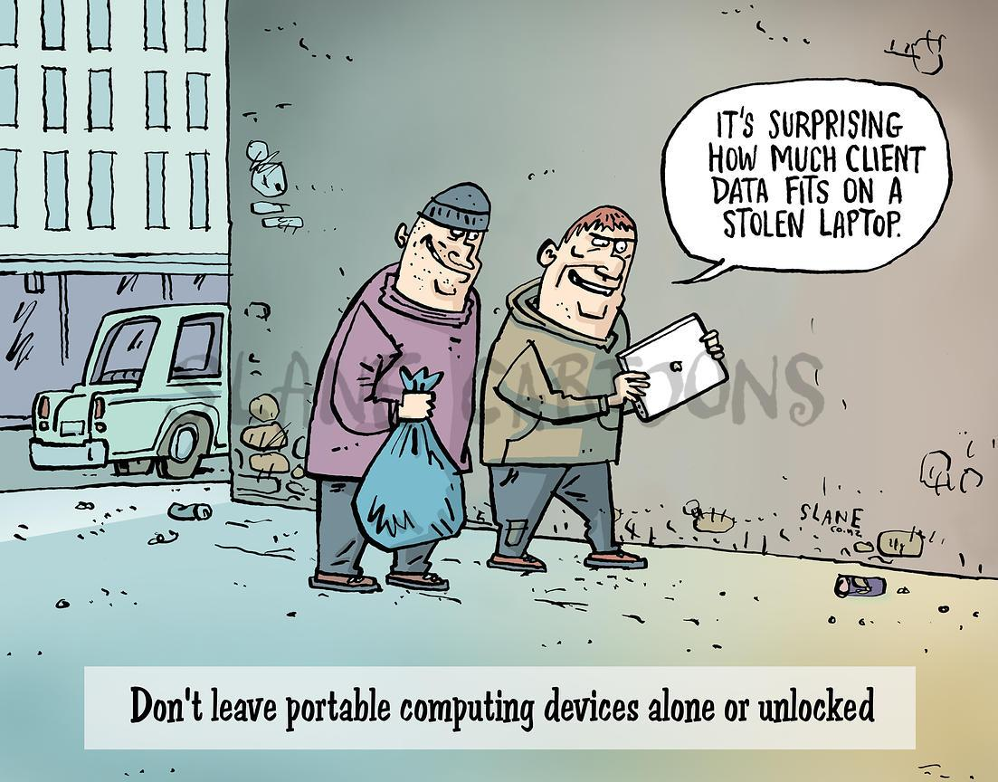
HIPAA
Regulations
Examples
Importance
Solutions
© All Rights Reserved - Chris Slane
Notes:
Joe Schmoe loads a SQL dump of the production database to his laptop
He stored patient files (unencrypted) on his laptop for testing bugs in his new UI
His machine isn’t encrypted
He is at Starbucks when 3 people rush in and steal his and 3 other’s laptops
Think this can’t happen to you?
NEXT SLIDE =>

Slide 8
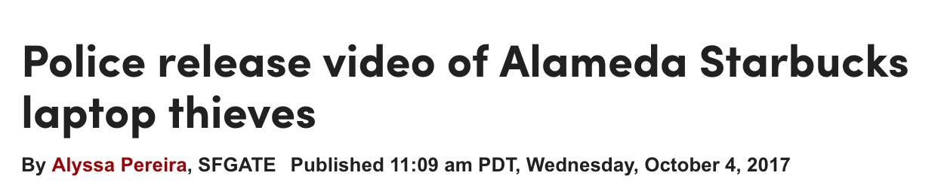
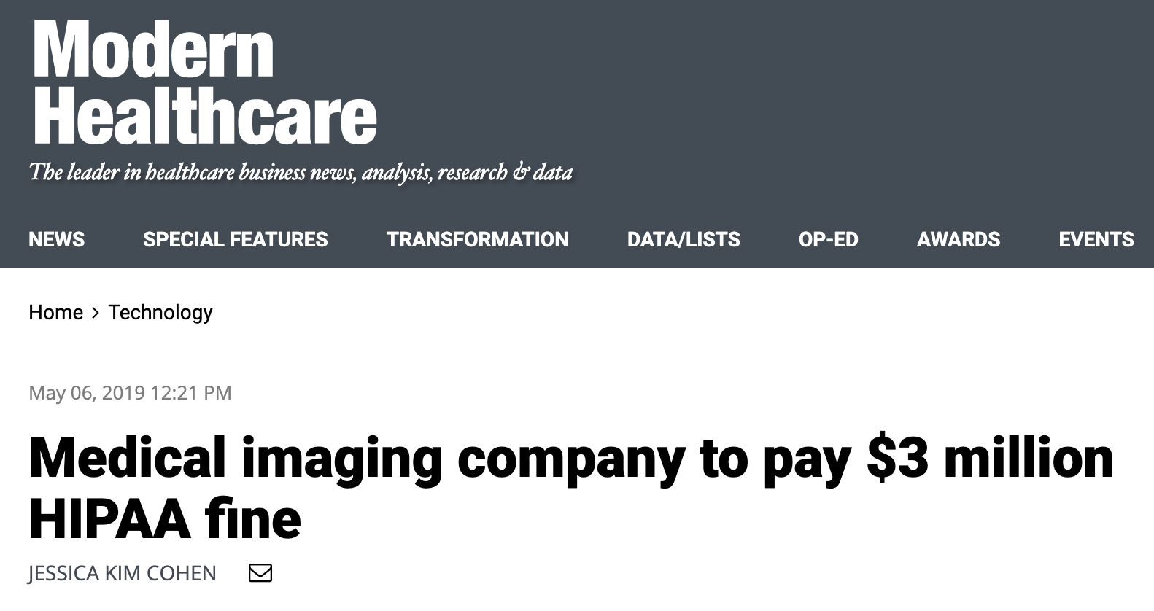
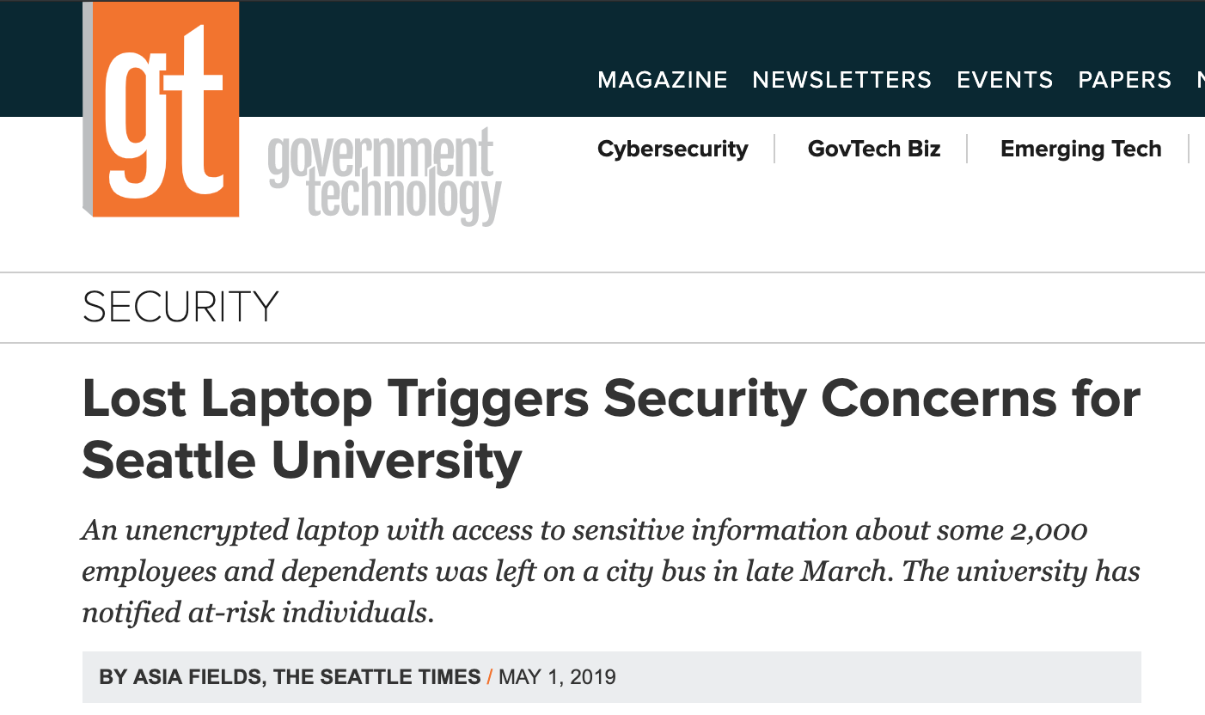
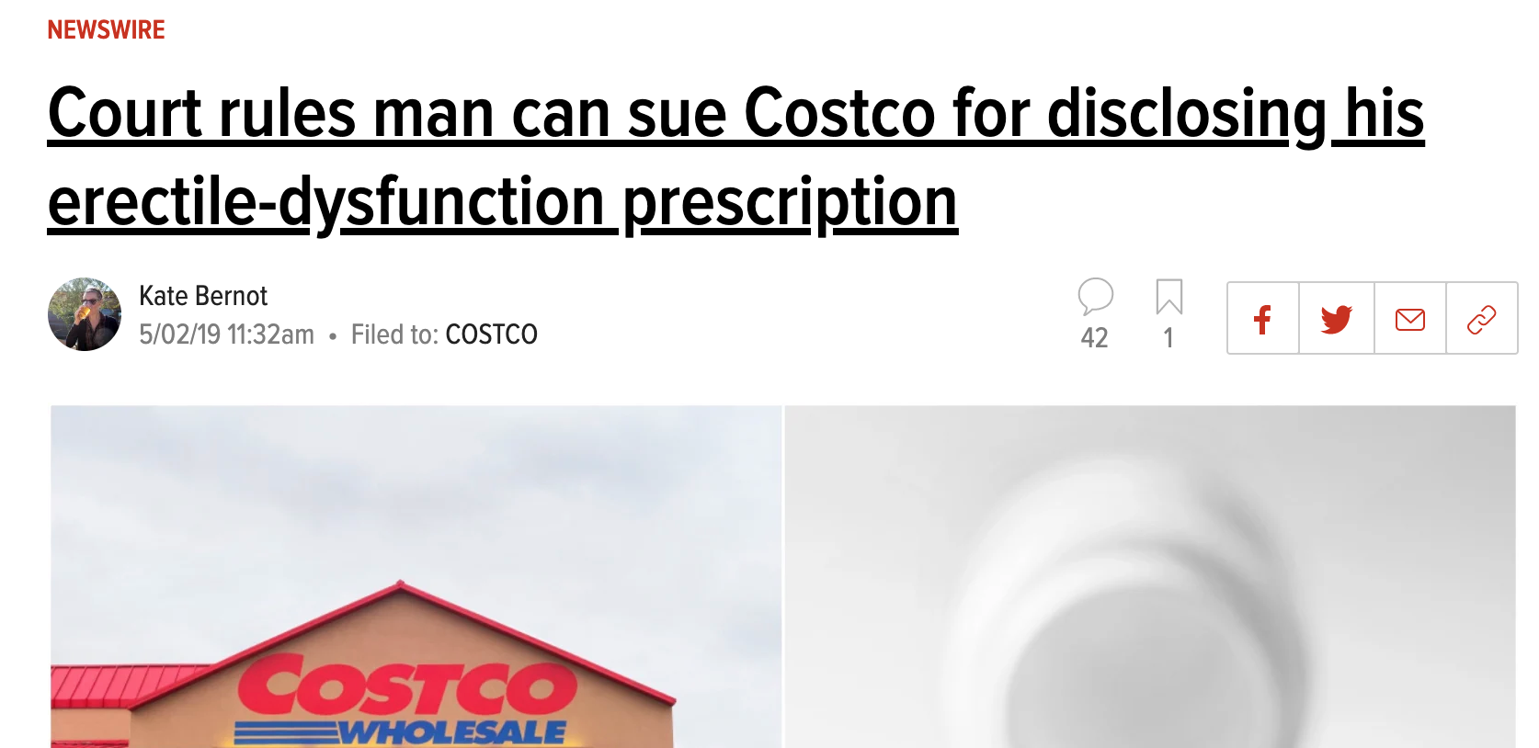
HIPAA
Regulations
Examples
Importance
Solutions

Slide 9
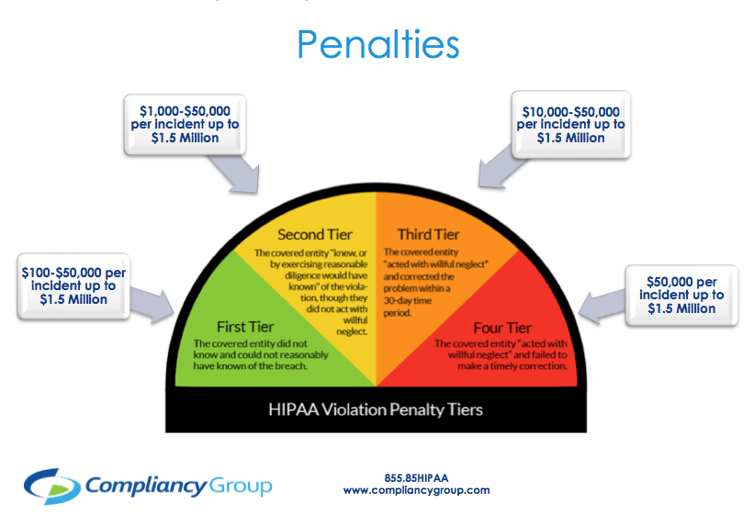
HIPAA
Regulations
Examples
Importance
Solutions
Notes:
What is HIPAA and why is patient health data so important?
https://www.modernhealthcare.com/technology/medical-imaging-company-pay-3-million-hipaa-fine
Patient data must be kept secure and out of sight of prying eyes
Accidental sharing of patient data can bankrupt even a mid-sized company
Fines range from $100 to $1.5 million per incident depending on severity (https://compliancy-group.com/hipaa-fines-directory-year/)

Slide 10
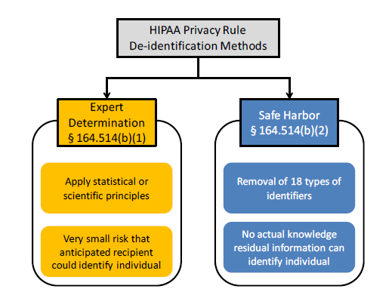
HIPAA
Regulations
Examples
Importance
Solutions

Slide 11
HIPAA
Regulations
Safe Harbor Method (164 somethin b2?)
Name
Street
All elements of dates but year
Telephone Number
Fax Number
Email Address
Driver Licenses and IDS
Vehicle IDs
Biometric IDs
Full face photos
Other comparable images
URL addresses
Social Security Number
Account numbers
CC/Debit
Passwords
Examples
Importance
Solutions
Notes:
So what if we go the safe harbor route what items are we going to have to de identify?

Slide 12
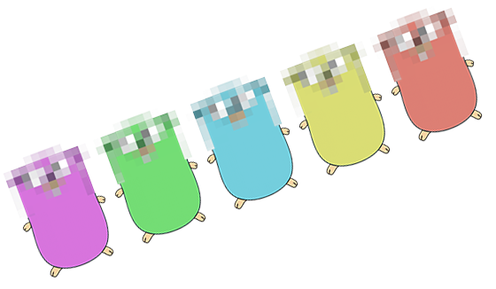
HIPAA
Regulations
Safe Harbour Method (164 somethin b2?)
Name
Street
All elements of dates but year
Telephone Number
Fax Number
Email Address
Driver Licenses and IDS
Vehicle IDs
Biometric IDs
Full face photos
Other comparable images
URL addresses
Social Security Number
Account numbers
CC/Debit
Passwords
Examples
Importance
Solutions
Notes:
So what if we go the safe harbor route what items are we going to have to de identify?

Slide 13
SmithRx Solution: Gonymizer

Slide 14
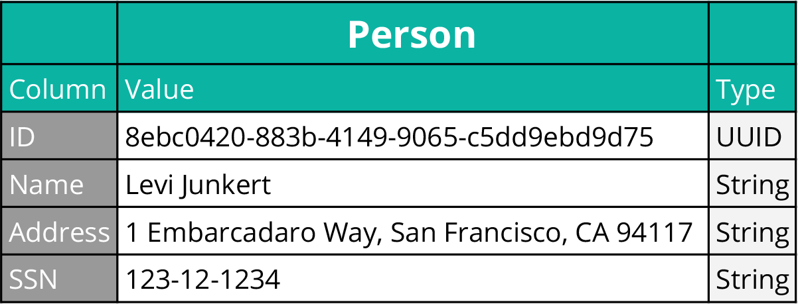

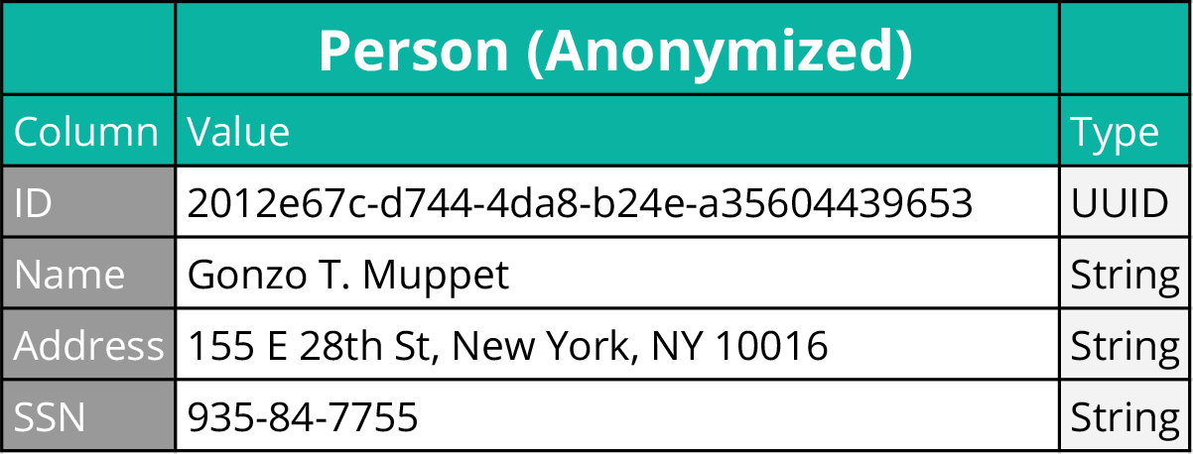
Gonymizer
Requirements
Design
Mapping

Slide 15
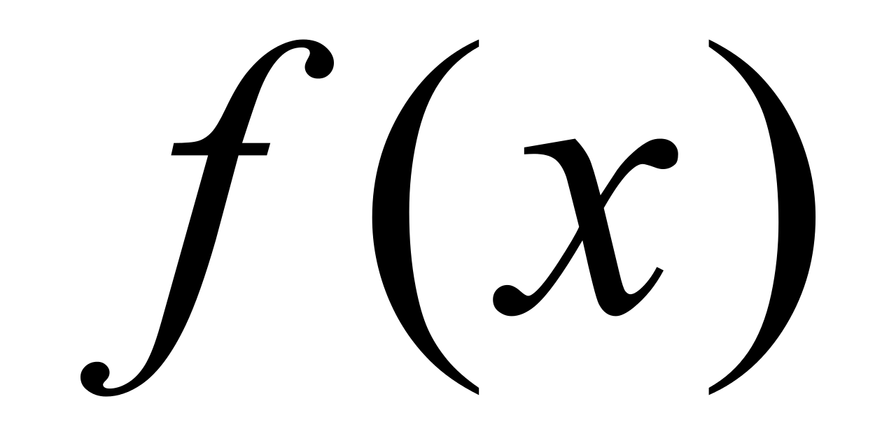
Gonymizer
Requirements
Design
Mapping

Slide 16
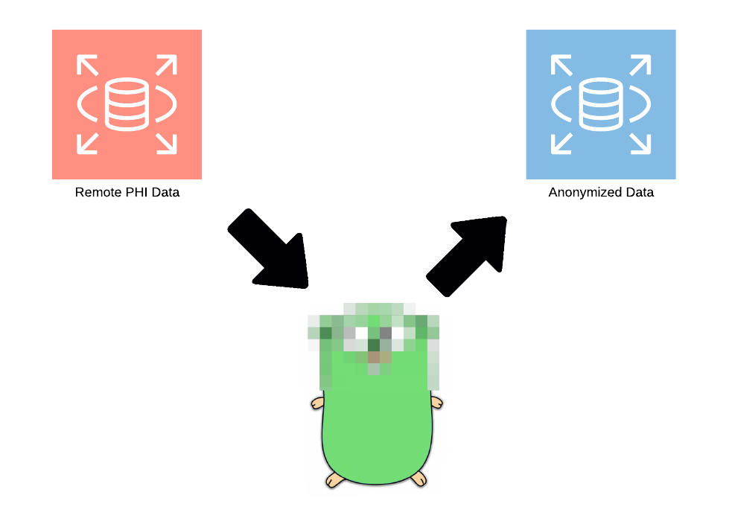
Gonymizer
Requirements
Design
Mapping

Slide 17
Gonymizer
Dump of the original PHI dataset
Load the data set into a PSQL host
Assignable scrambler function(s)
A map to know which columns to anonymize
Must keep relationships intact
Must be able to be automated
Requirements
Design
Mapping
Notes:
Kind of

Slide 18
Gonymizer
Separated Commands
Dump
Downloads SQL dump file
Map
Build and maintain an anonymization map for
Schemas
Tables
Columns
Process
Anonymizes columns according to map
Load
Loads the anonymized file
Requirements
Design
Mapping
Notes:
Dump
Creates a dump file containing PHI/PII from a PostgreSQL database
Map
Map creates/modifies the map file for a PostgreSQL database
Process
Process will use the map file to anonymize data from a PostgreSQL dump file
Load
Load an anonymized dump file into a PostgreSQL database

Slide 19
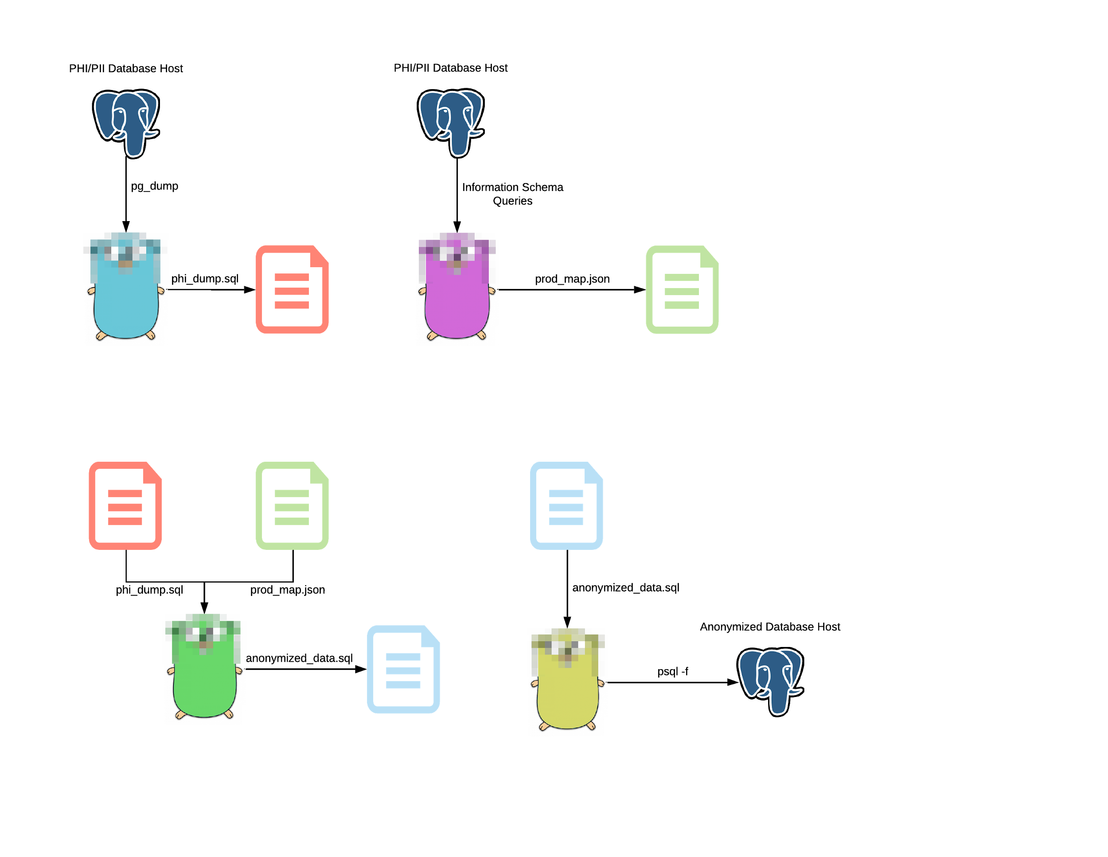
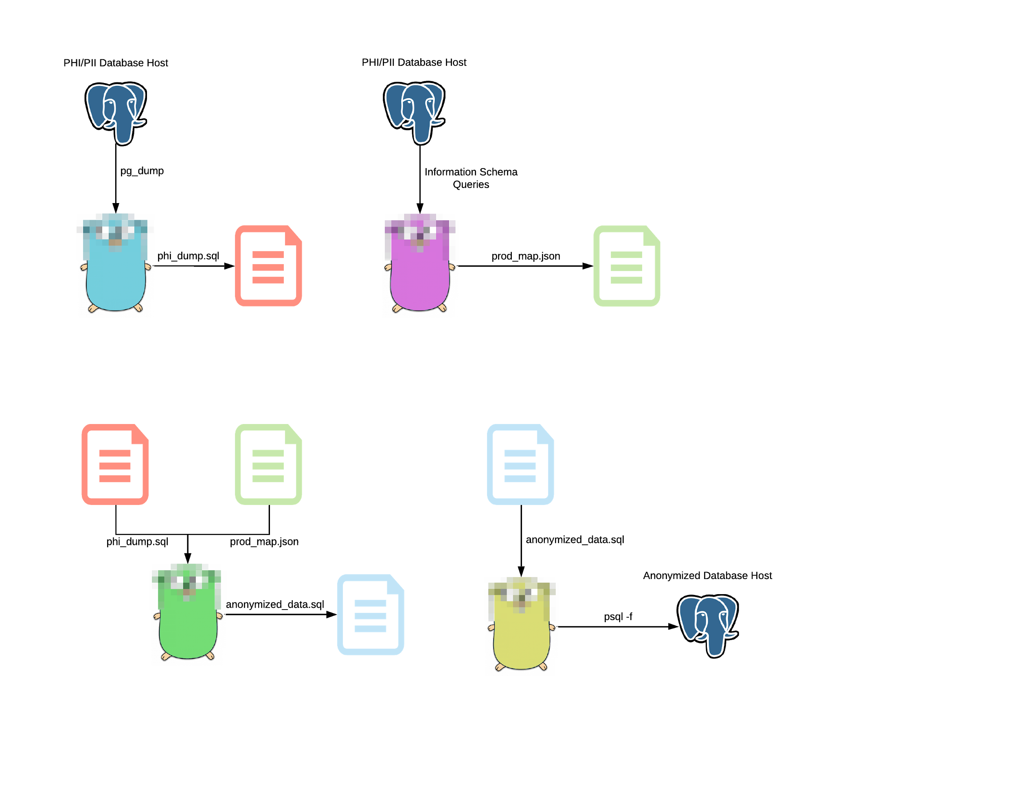
Gonymizer
DUMP
Requirements
Design
Mapping
LOAD
Notes:
Dump
Creates a dump file containing PHI/PII from a PostgreSQL database
Map
Map creates/modifies the map file for a PostgreSQL database
Process
Process will use the map file to anonymize data from a PostgreSQL dump file
Load
Load an anonymized dump file into a PostgreSQL database

Slide 20
Gonymizer
PROCESS
Requirements
Design
Mapping
MAP

Slide 21
Gonymizer
Requirements
Design
Mapping

Slide 22
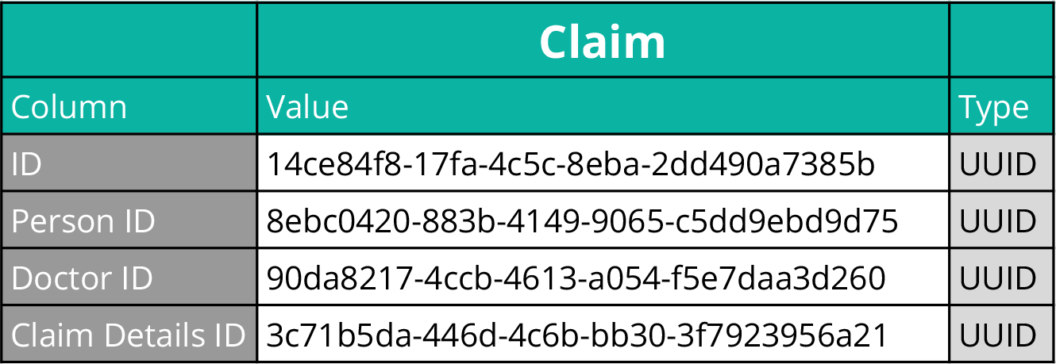
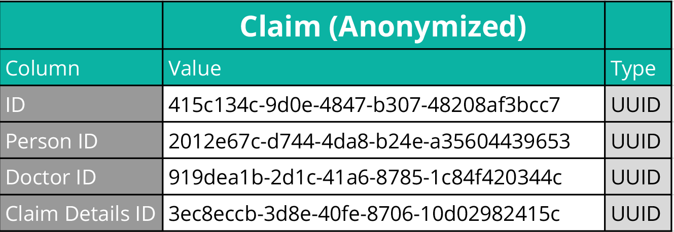
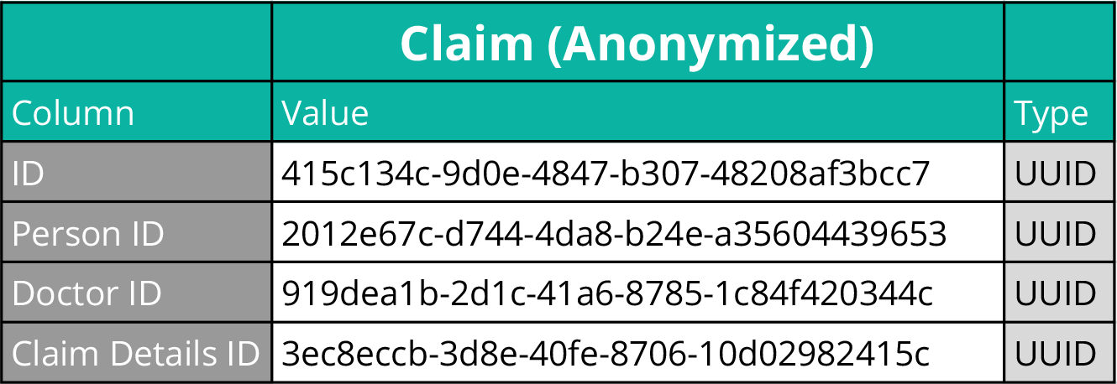
Gonymizer
Requirements
Design
Mapping
?

Slide 23
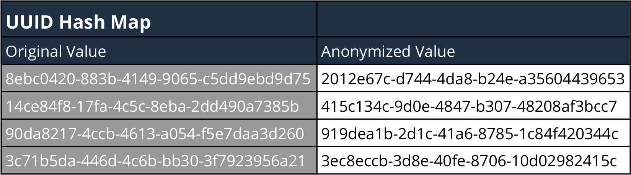
Gonymizer
Requirements
Design
Mapping

Slide 24
Gonymizer
Requirements
Design
Mapping

Slide 25
Gonymizer
Requirements
Design
Mapping

Slide 26
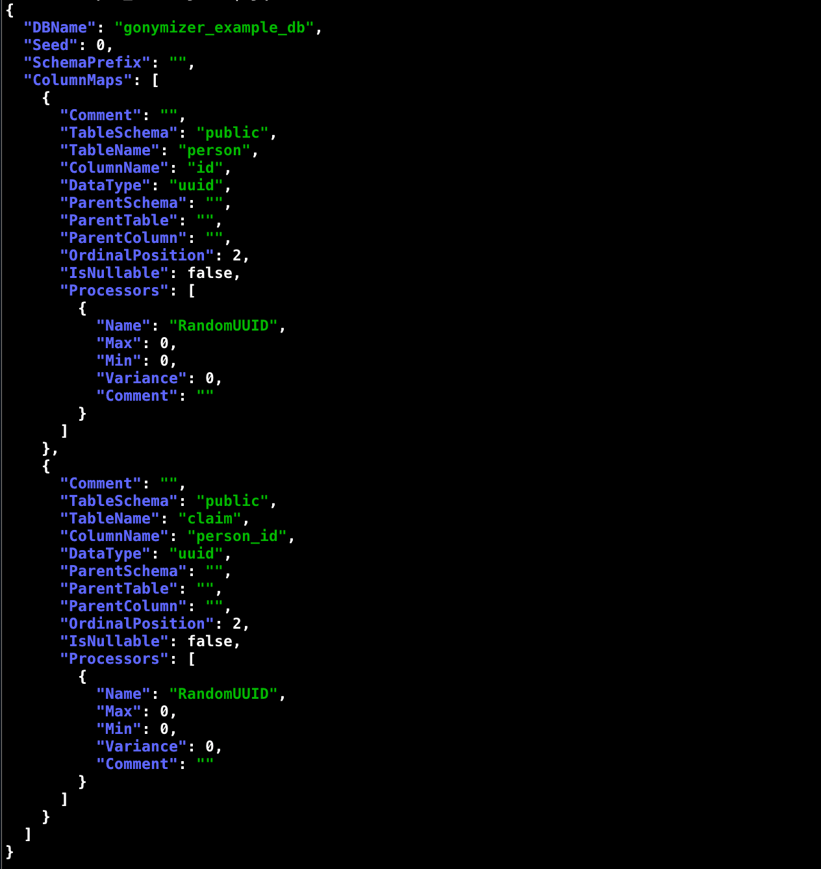
Gonymizer
Requirements
Design
Mapping
Person

Slide 27
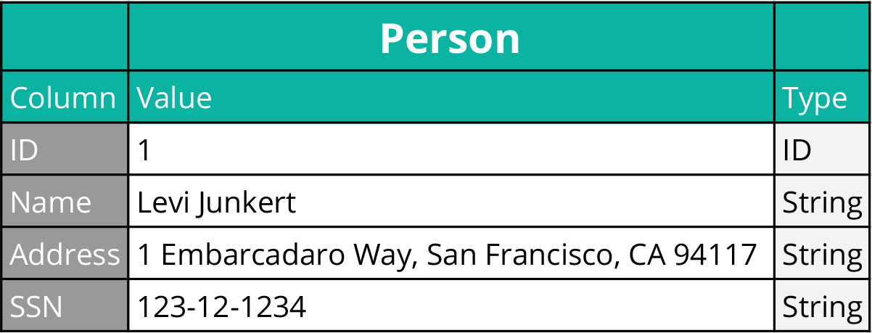
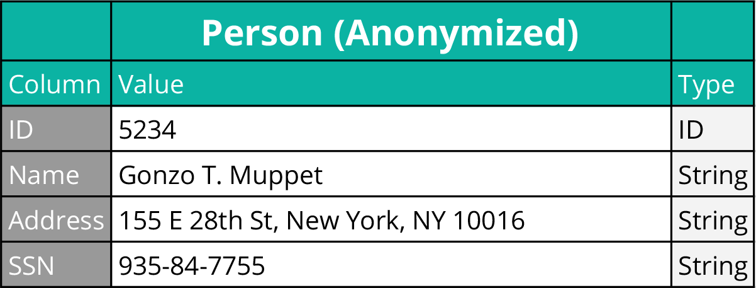
Gonymizer
Requirements
Design
Mapping
Notes:
WITH IDs

Slide 28
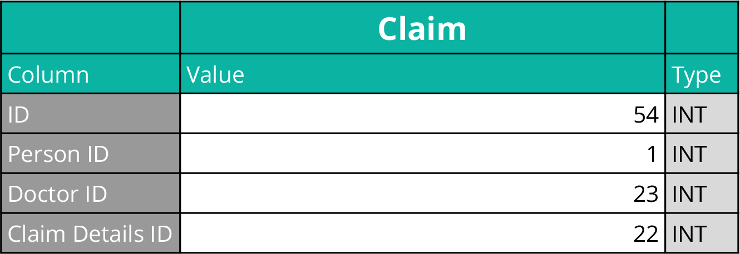
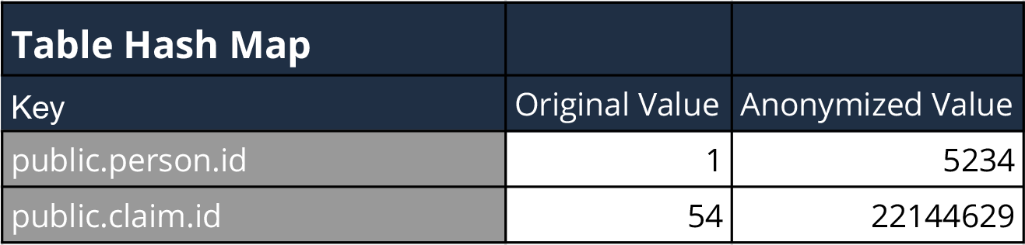
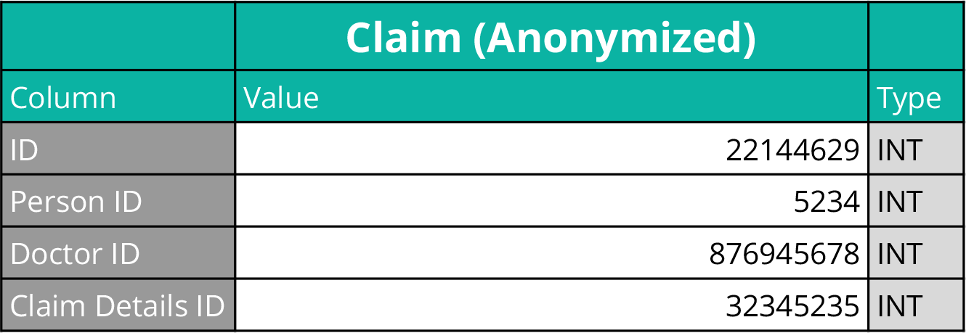
Gonymizer
Requirements
Design
Mapping

Slide 29
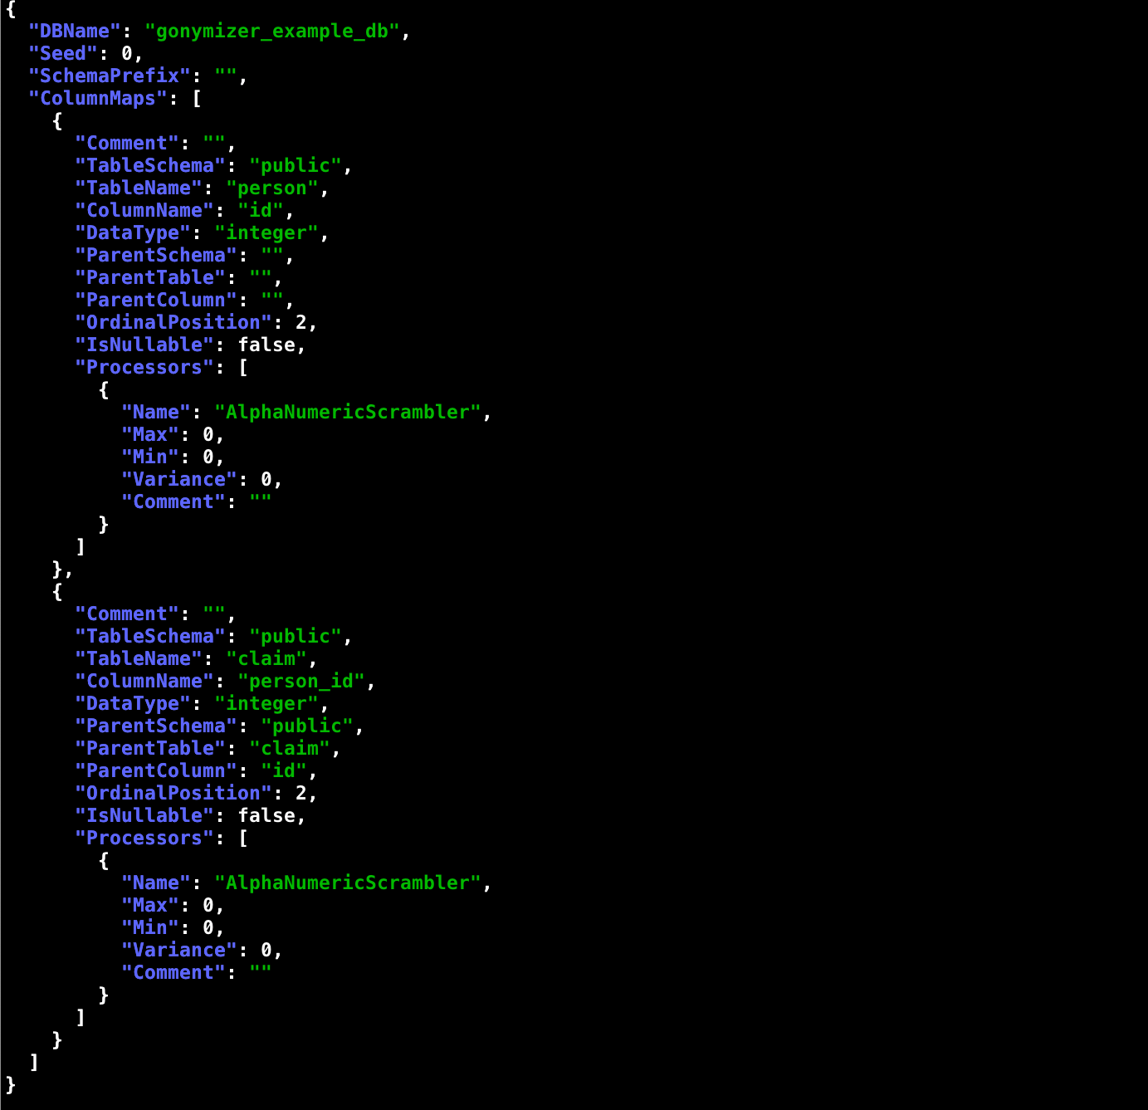
Gonymizer
Requirements
Design
Mapping

Slide 30
Gonymizing Environments

Slide 31
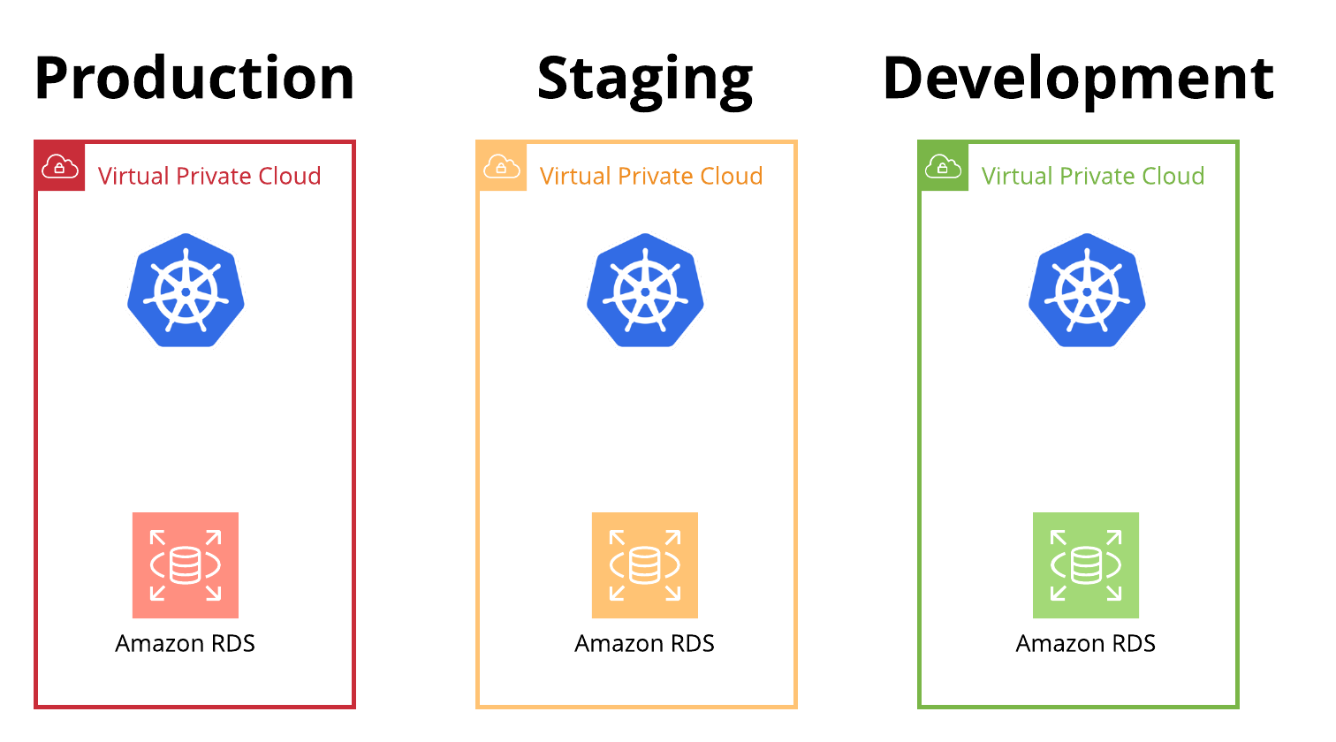
Automation & Kubernetes
Dump
Process
Load
Notes:
A small example of how to separate dev, staging, and production can be seen in the Dockerfile on Github

Slide 32
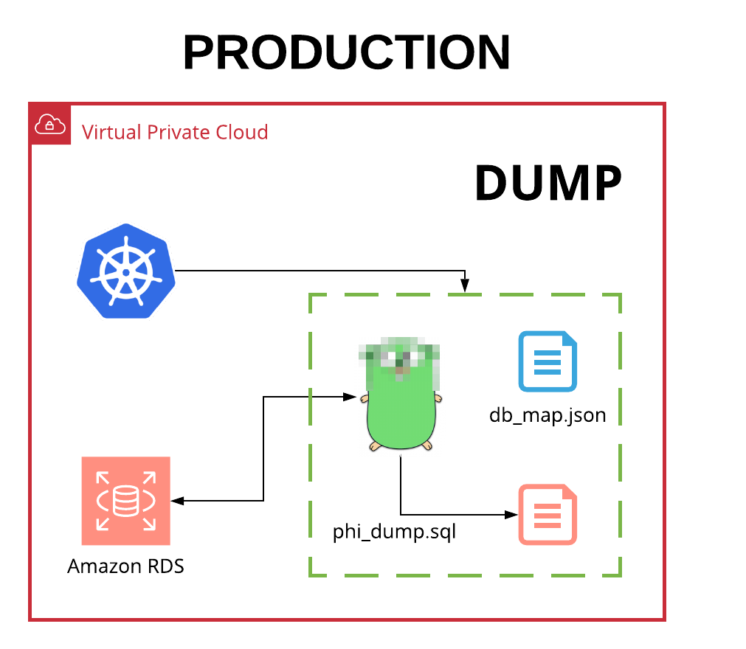
Automation & Kubernetes
Dump
Process
Load
Notes:
A small example of how to separate dev, staging, and production can be seen in the Dockerfile on Github

Slide 33
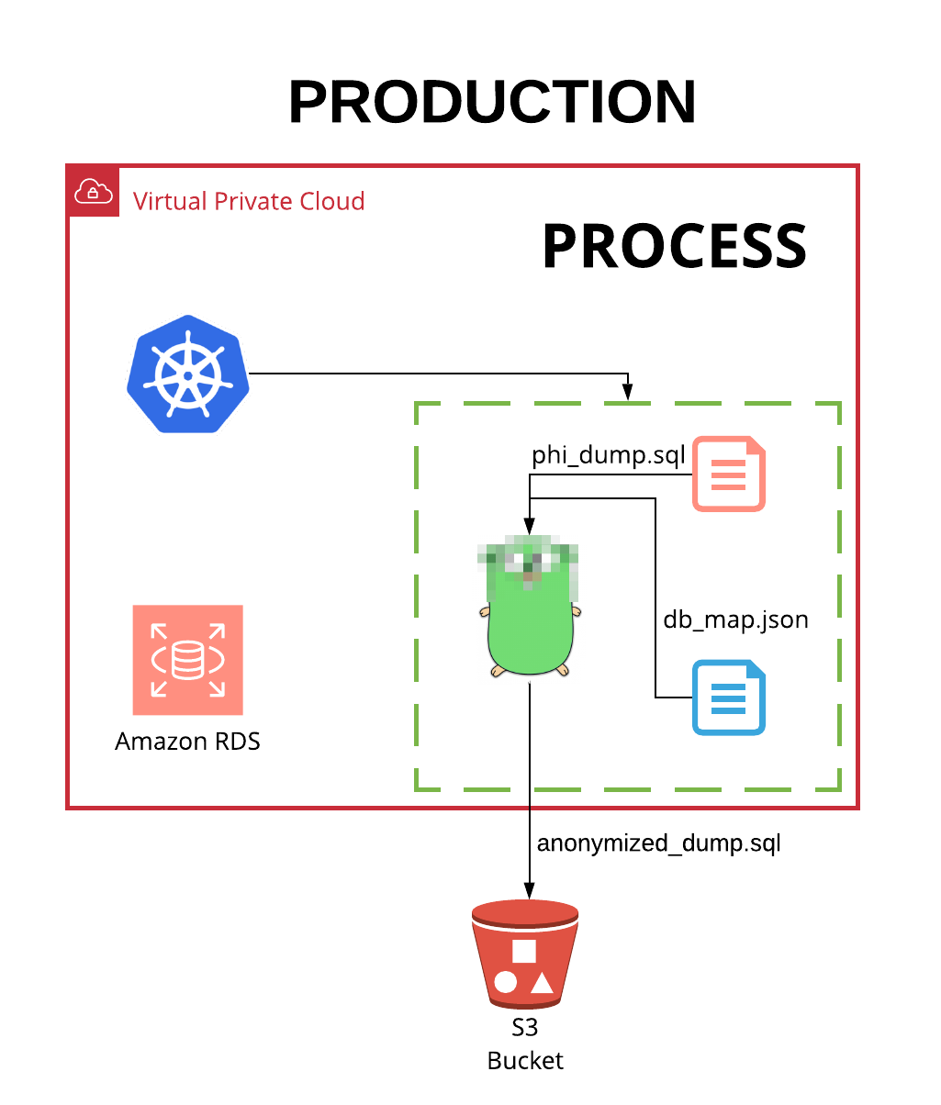
Automation & Kubernetes
Dump
Process
Load
Notes:
A small example of how to separate dev, staging, and production can be seen in the Dockerfile on Github

Slide 34
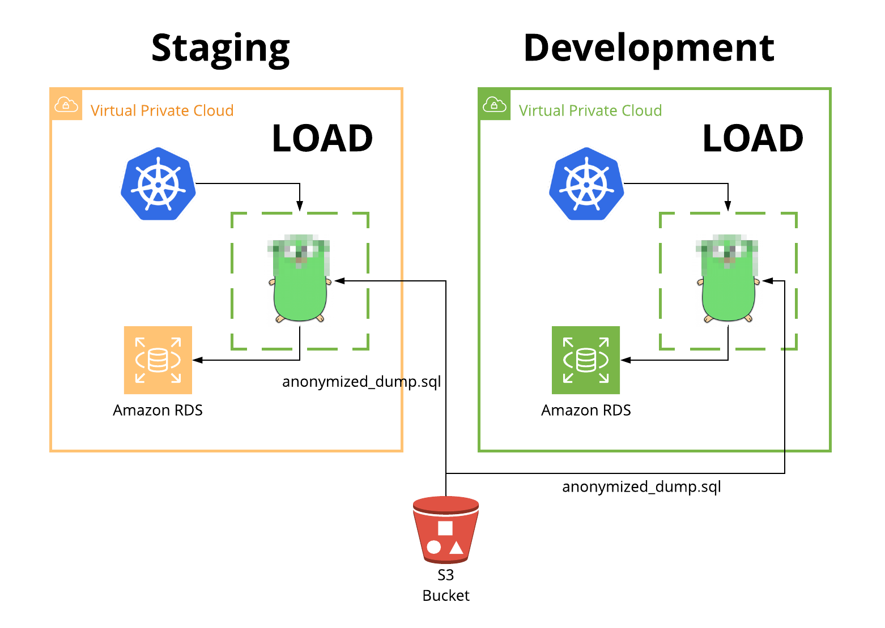
Automation & Kubernetes
Dump
Process
Load
Notes:
A small example of how to separate dev, staging, and production can be seen in the Dockerfile on Github

Slide 35
Now a demo
The demo database comes from the Dell-Store 2 collection found at: http://pgfoundry.org/projects/dbsamples/

Slide 36



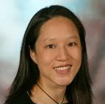



We are hiring mission-driven devs and PMs passionate about fixing U.S. healthcare
Office Location
San Francisco, CA
Current Positions Open
Software Engineer (mid-level)
Senior Software Engineer
Product Manager (mid-level)
Senior Product Manager
Send Resume To
recruiting@smithrx.com

Slide 37
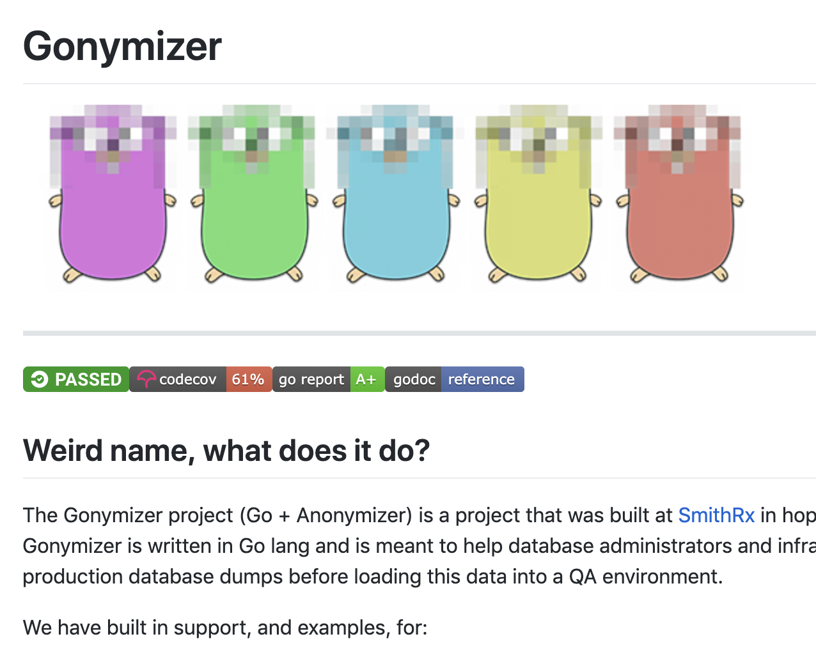
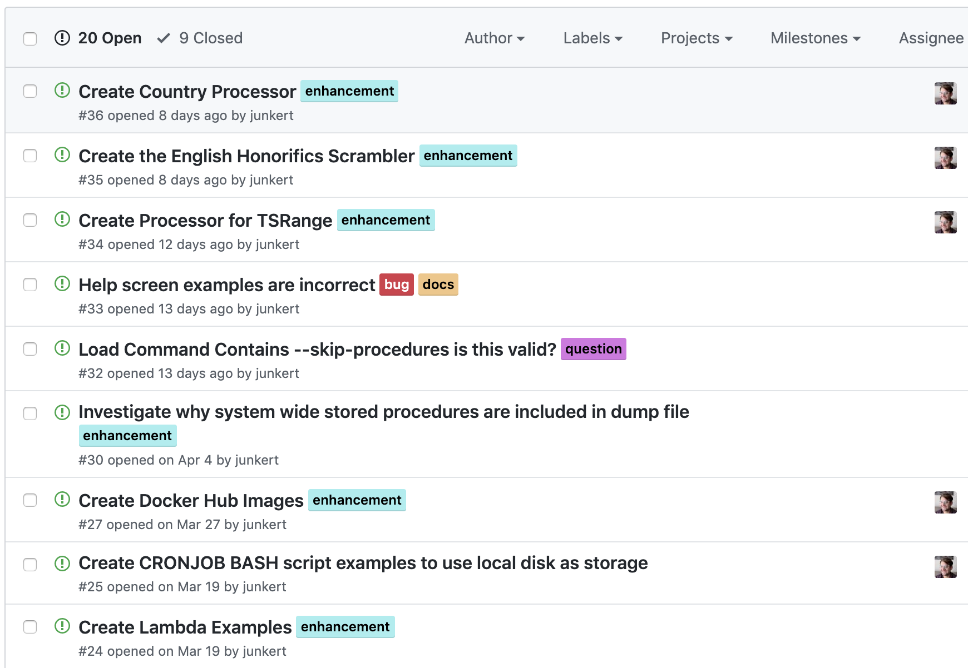
Call for Contributors
https://github.com/smithoss/gonymizer

Slide 38
Thank you

